Slide 1

Transition from School to Adult Life & Special Needs Trusts

Slide 2
About The Arc of Northern Virginia
  We promote and protect the human rights of people with ID/DD and actively support their full inclusion and participation in the community throughout their lifetimes.
  Founded in 1962 by a group of families looking for school services for their children.
  Affiliated with The Arc of the US and The Arc of Virginia
  21 chapters in VA/Over 600 across the country

Slide 3
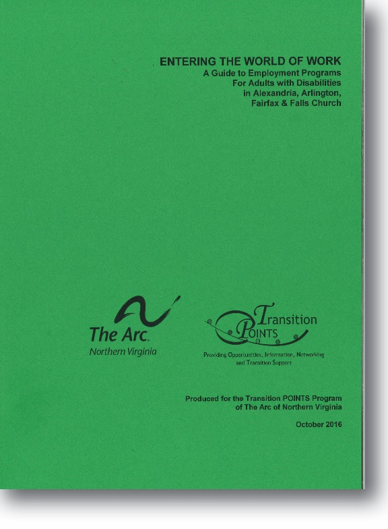
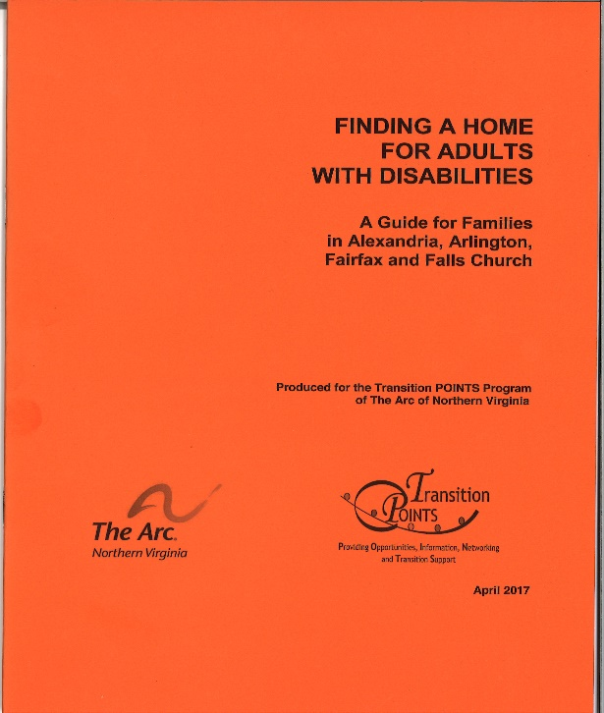
Our Services
Educate & Empower
  Transition POINTS (available in Korean)
  Webinars/YouTube
  Transition Series
  Transition Lunch & Learns
  Information & Referral (I&R Portal)
  Resource Library
Advocacy
  Legislative: Local and State
  Self-Advocacy: People First for Young Adults & People First (ALLY) Toastmasters

Slide 4
Our Services Continued ….
Services
  Support Coordination for DD Waiver
  Guardian of Last Resort (GOLR)
  Pooled Special Needs Trust
  Family Funded & Self Funded
  Trust Talk Tuesdays & First Fridays
  Tech for Independent Living
  Arc2Indepenence app provides general and customized lessons for daily living, employment, safety and travel training skills
Funded by grants, fundraising events, donations, membership, waiver reimbursement for support coordination services

Slide 5


Transition from School to Adult Services
Based on eligibility that is specific to each agency
And funding availability
Notes:
Special education is entitlement based with no waiting lists. Adult services have eligibility criterea, limited funding, and waiting lists.

Slide 6

Must Do List
Apply for a Medicaid DD Waiver
Apply for Pre-ETS with DARS
Explore Adult Service Providers (Day Support, Employment, Self-Directed Services) Do Informational Interviews
Establish a Special Needs Trust/Write a Will
Apply for SSI the month after your child turns 18
Establish Decision Making Supports including HIPPA Forms and Power of Attorney
Obtain a government issued ID
Apply for MetroAccess and/or Reduced Fare Card
Support your young adult to practice self-advocacy and independent living skills

Slide 7
To Do List Continued …
It’s a Good Idea to do
Maybe you’ll do depending on your path
Sign up for The Arc of Northern Virginia’s E-newsletter, Resources
Explore Social and Recreation Opportunities
Build a Supported Decision Making Team
Explore housing options and housing supports
Establish an ABLE Account
Apply for Vocational Rehab Services from DARS if goal is competitive employment
Research and apply for post-secondary options i.e. two or four year colleges, Mason LIFE, etc.
Petition for guardianship

Slide 8
Funding the Future with Public Funds:
DD Medicaid Waivers
Call the Arlington DHS (703) 228-1700 to apply for the Developmental Disabilities Waivers
There are 3 DD Waivers: Community Living Waiver, Family and Individual Supports Waiver, and the Building Independence Waiver
DD Waivers cover a menu of services for home, nursing, work and community.
Long term employment and day support services, respite, assistive technology, environmental modifications, skilled nursing, companion care, residential supports, and other services.
Eligibility Criteria:
  Functional Ability (VIDES Assessment): Must show functional need in 3 out of 8 categories: Health Status, Communication, Task Learning Skills, Personal/Self Care, Mobility, Behavior, Community Living Skills, and Financial Self-Sufficiency
  Diagnosis: DD Diagnosis and IQ
  Financial: $2000 Resource Limit, $2829 per month (300% of 2024 SSI amount)
Notes:
CSB is first point of entry for adult services and it’s your Department of Human Services. Contact the CSB for a screening, then complete the application they send, then VIDES assessment. See our YouTube Channel for our webinar on Medicaid Waivers
Visit our online Resource Library for detailed information on waivers
Visit our online Resource Library to view the VIDES Assessment. VIDES VA Individual DD Eligibility Survey

Slide 9
DARS
VA Dept of Aging and Rehab Services
DARS is a federal-state program offering vocational rehabilitation services for individuals with disabilities to prepare for, enter, and maintain employment Alexandria Office 703-960-3411
5 Pre-ETS (Employment and Transition Services) – eligible students ages 14-22 (with an IEP, 504, etc.)
*** no waiting list
  Job exploration counseling
  Work based learning experiences
  Counseling on opportunities for enrollment in post secondary education and training programs
  Workplace readiness training to develop social skills and independent living
  Instruction in self-advocacy
Notes:
WIOA – the workforce investment and opportunity act: expanded opporutnities to provide more services and expanded transition services while in school

Slide 10
DARS
Vocational Rehabilitation (VR)
VR Services is an eligibility program: need a documented disability that causes a substantial barrier to getting or keeping a job and meet financial eligibility
VR Services help people get ready for, find, and keep a job
Includes career exploration, job seeking, job development, training, rehabilitative engineering, assistive technology
Provides short term services
Wilson Workforce and Rehabilitation Center (WWRC)
  Provides individuals with disabilities comprehensive and individualized services that lead to employment. Provides vocational evaluation, vocational training, medical rehabilitation, driver instruction, and other services.

Slide 11
Adult Service Providers
Explore Adult Service Providers (or Employment Service Organizations) that offer individual supported employment, group supported employment, meaningful day supports and do information interviews
Discuss schedule – what does a typical day look like?
Transportation to and from employment or day program
What meaningful day activities are provided.
Think about strengths and goals

Slide 12



Funding the Future with Public Supports
How Do They Connect?
Medicaid DD Waivers
(life long supports)
Funding administered by the
CSB
(Point of Entry)
County General Funds
** Only Fairfax, Arlington, & Alexandria
*** Self Directed Services available in Fairfax & Arlington
Private Pay
Adult Service Providers
DARS
(short term supports)
VR Services
For Competitive, Integrated Employment
Pre-ETS
Available to all students with a disability while in school

Slide 13

Public Supports Continued: SSI
Supplemental Security Income (SSI)
  Apply the month after your child turns 18
  Eligible if disability prevents an individual from working
  Cash based monthly assistance: $943 in 2024
  Meets basic needs: food, clothing, and shelter
  Resource limit of $2000
  Provide a room and board agreement during interview
  Use our Resource Library to determine rent

Slide 14
Social Security Tips & Tricks
Establish a My SSA Account
Be as descriptive as possible when responding to questions
Follow up with physicians that you’ve listed on application
When you call SSA keep a record of the date, name of the person, what you asked, what they told you
Make copies of all documents you give SSA
Promptly open and read all mail sent by SSA. Comply with deadlines. Keep all paperwork
Once working, report pay stubs each month to SSA.Keep wage records in a file.
Report life changes to SSA – address, loss of job, etc.

Slide 15
Funding the Future with Private Funds
These financial tools protect eligibility and enhance quality of life
Special Needs Trust
ABLE Account (ABLENow)

Slide 16

First-Party/Self-Funded Special Needs Trusts:
Established by: Individual w/ disabilities, parent, grandparent, Guardian, court-ordered, or agent under Power of Attorney
Why/When: ONLY WHEN NECESSARY: when person with disabilities needs to apply for or protect benefits &/or cannot manage money
How to Fund: Unexpected inheritance, lump-sum pay back from SSA, jury-decision, settlement, income, adult child support, military survivor benefit (SBP) program, alimony, lottery
What Happens After Passing: Medicaid payback then heirs at law, OR, contribution to The Foundation of The Arc of Northern Virginia
*must be the beneficiary’s money

Slide 17
Third-Party/Family-Funded Special Needs Trusts:
Established by: Parents, Relatives, Friends
Why/When: Second to passing; may fund the trust prior to death with seed money (minimum of $500)
How to Fund: Inheritance, life insurance policy, transfer from another trust, contributions, real property, etc.
What Happens After Passing: The grantor (who establishes the trust) decides who will inherit the remaining funds
*cannot be the beneficiary’s money

Slide 18
The Arc of Northern Virginia SNT Fees:
The Arc’s one-time enrollment fee: $1050.00 (subject to change)
  2nd trust for same individual or their sibling: $775.00
Annual fee of each after trust establishment:
  Unfunded account: $65.00
  OR
  Funded account:
    Seed money minimum: $500.00
    Annual Management and Trustee fee: 1.44%
    Tax preparation fee for active accounts: $40.00
Termination fee: $250.00 (subject to change)

Slide 19
How To Establish a SNT with The Arc:
Learn about SNTs and determine if one is right for you/your loved one (our website has lots of free information)
Schedule a consultation, if more information is needed, or you want to discuss your case
Collect documentation needed for trust establishment
Schedule an establishment appointment (online, or with our Administrative Coordinator)
Pay enrollment fee and attend your establishment appointment
After the appointment, we need a notarized copy of the signature page to officially process the trust
Upon receipt of necessary documents, your trust is sent to KeyBank and will be established

Slide 20
Open an ABLE Account
The Achieving a Better Life Experience Act of 2014 allows states to set up tax advantages savings accounts for individuals with disabilities for disability related expenses
Can be used as an additional tool for financial planning
ABLEnow created in 2016–directed by Virginia529
Open up online
Must be used for Qualified Disability Expenses. Examples include education, transportation, assistive technology, health, prevention and wellness, employment training
Up to $18,000 per year, not considered income for SSI purposes up to $100,000
Fees are $39 per year and asset management fees range from .37%-.40%. No enrollment fee

Slide 21
Build a Supported Decision Making Team and Utilize a Spectrum of Legal Tools
  Least Restrictive Legal Supports to Be Used First
  Social Security Representative Payee
  HIPPA Forms
  Power of Attorney, Education Power of Attorney, Medical Power of Attorney. Powers of Attorney can be customized!
  Guardianship
  Limited Guardianship or Full Guardianship
  Limited guardianship may retain certain rights, like voting or driving
  Fees generally range from $2500 to $4000
  Guardianship Process generally takes 2 to 3 months
  Guardianship must be done with an attorney, usually an elder law attorney

Slide 22
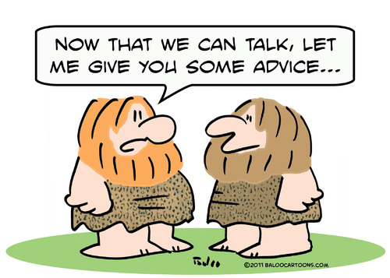
What is Supported Decision Making?
At its most basic, Supported Decision Making is having people you trust to help you make decisions
Part of our culture for everyone
Can be formal or informal

Slide 23

Why Should You Consider SDM?
Self-determination studies on safety and quality of life
Increasing independence
Dignity of Risk and learning from mistakes
Preservation of Rights
Minimal to no cost

Slide 24
SDM
What if???
No studies have shown guardianship increases safety, but studies do show that self-determination does
SDM utilizes and builds on strengths of the individuals and their team
We all learn to make better decisions by making mistakes
Most people make some bad choices everyday, and that is okay
Putting SDM into action
Read about it and put some ideas on paper
Check out The Arc of Northern Virginia’s Pilot Project
Can use legal tools in addition to SDM

Slide 25
Additional Resources
https://thearcofnova.org/programs-services/library/
https://padlet.com/dmonnig/2023-the-arc-of-northern-virginia-transition-series-6rwyso2sx86u8jd3
https://www.youtube.com/user/VideosatTheArcofNoVA
The Arc’s Center for Future Planning to build a future plan https://futureplanning.thearc.org/
Disability Law Center of Virginia www.dlcv.org
PEATC (Parent Education Advocacy and Training Center) https://peatc.org/
ECNV (Endependence Center of Northern Virginia) https://ecnv.org

Slide 26
Thank You!
Diane Monnig
Director of Programs
The Arc of Northern Virginia
dmonnig@thearcofnova.org
703-208-1119 ext. 118
Ana Hughes
Director of Special Needs Trusts
ahughes@thearcofnova.org
703-208-1119 ext. 130

